Slide 1
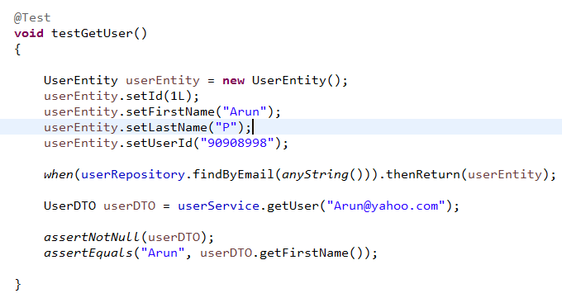
Testing Service Layer Code with JUnit 5 and Mockito
JUnit used to test particular method in the class
Normally JUnit testcases won’t communicate with Databases and won’t send any HTTP requests to any services.
JUnit testcases are easy to run and they often can be run every time we build the code

Slide 2
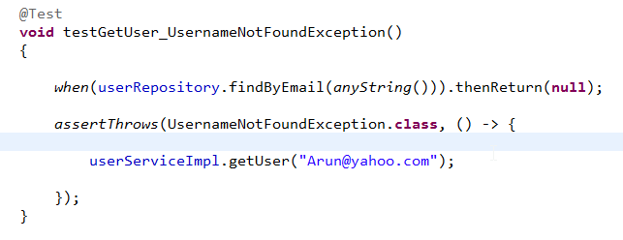
Testing Service Layer Code with JUnit 5 and Mockito
Expect an Exception with assertThrows()

Slide 3
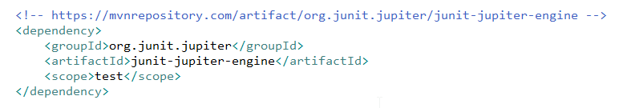
Testing Service Layer Code with JUnit 5 and Mockito
Run JUnit 5 Test Cases with Maven

Slide 4
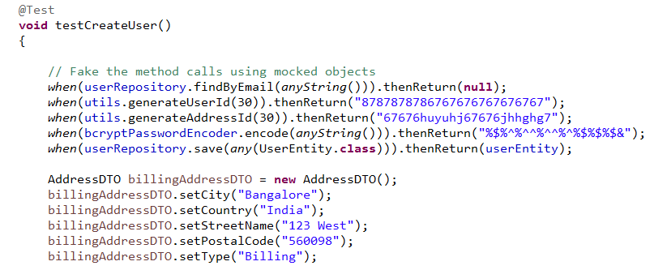
Testing Service Layer Code with JUnit 5 and Mockito
The testCreateUser() method. Mocking Objects.

Slide 5
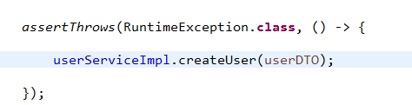
Testing Service Layer Code with JUnit 5 and Mockito
Assert an Exception is thrown in the createUser() method

Slide 6
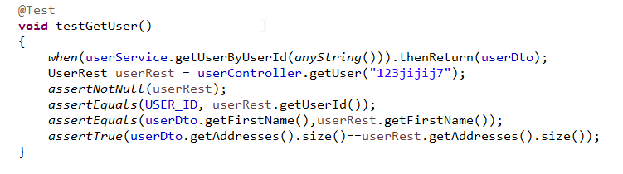
Testing Rest Controller Methods with JUnit 5

